Slide 1
RGUHS Research Workshop
How to frame a Research Question
Dr. M. A. Shekar. M.D.
Director & Diabetologist
Apoorva Diabetes Foundation & Chowdaiah Medical Center.
Mysuru.

Slide 2
What is Research?
“The organised, structured, and purposeful investigation aimed at discovering, interpreting, and revising human knowledge on different aspects of the world by someone first hand.”

Slide 3
The Five Page Protocol
Page One
- Title, Specific objectives, significance section
Pages Two- Five
Design
Subjects
Variables
Statistical Issues
Timetable Ethical considerations
References
Appendices

Slide 4
Developing Research Question & Hypothesis

Slide 5
What is a Research question?
An uncertainty in a population the investigator wishes to resolve
What is a Hypothesis?
Transformation of a research question into an operational statement.
“ Hypothesis is a statement or explanation that is suggested by knowledge or observation but has not yet been proved or disproved.”

Slide 6
Research question – 1
Does delayed cord clamping at birth improve hemoglobin at 6 months in term neonates born to anemic mothers?
Hypothesis – 1
In term non-LBW neonates born to mothers with Hb <10 G/dL, cord clamping after cessation of pulsations increases Hb by 2 g/dl at 6 months when compared to clamping of cord immediately after delivery.

Slide 7
Research question – 2
Does phacoemulsification cause a lowering of Intraocular Pressure in glaucoma patients?
Hypothesis – 2
In patients aged >30 years with moderate glaucoma controlled on 1-2 glaucoma drugs, phacoemulsification reduces the Intraocular Pressure by more than 10% over a time span of 12 months.

Slide 8
A good research question - FINERS
Feasible
Interesting
Novel
Ethical
Relevant
Scalable

Slide 9
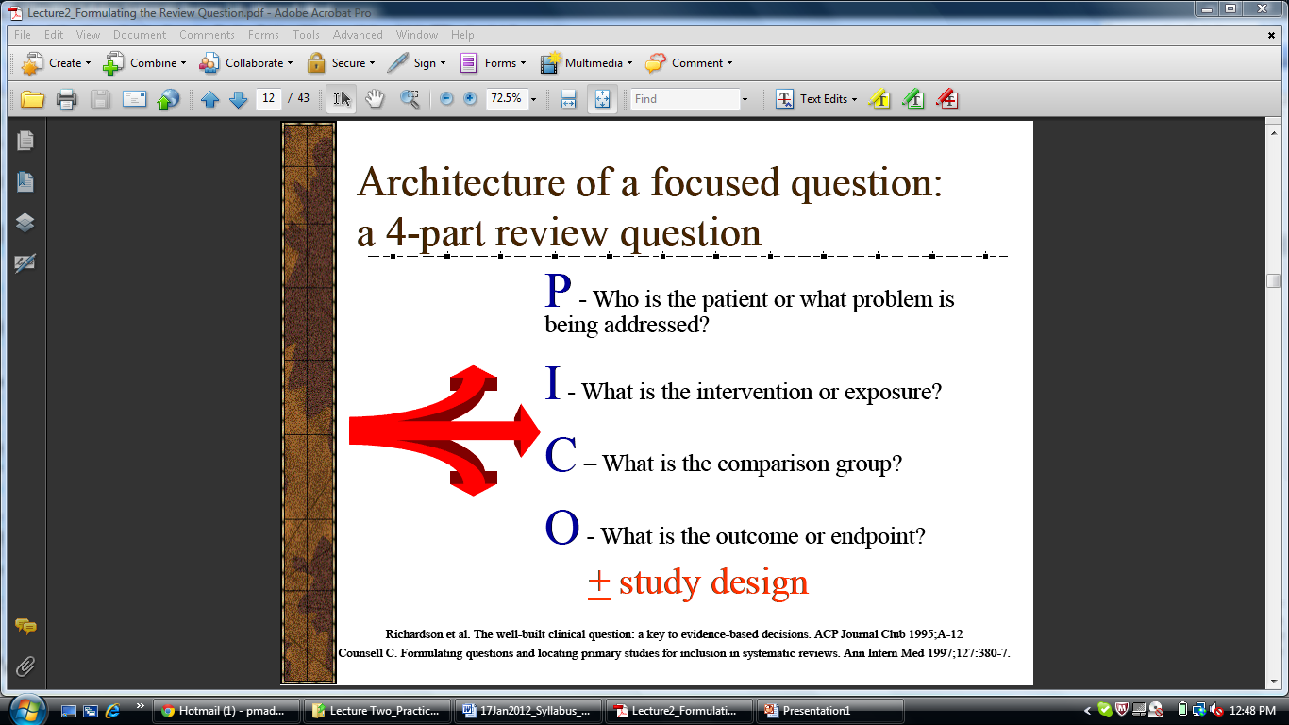
Framing your research question - PICO
TS
A description of the Populations P
An identified Intervention I
An explicit Comparison C
Relevant Outcomes O
Time frame of the study T
Study design S
Notes:
9

Slide 10
Research Qs………….
Would the topical skin application of sunflower oil as a skin barrier enhancing emollient reduce nosocomial infections in preterm infants compared to standard care ?
Population –
Intervention –
Comparison –
Outcome –
Preterm infants
Sunflower oil
Standard care
Nosocomial infections

Slide 11
Research Qs………….
In middle-aged people with a family history of risk for stroke, does daily treatment using low-dose aspirin result in similar rates of prevention of heart attack or stroke compared to Clopidogrel?

Slide 12
Research Qs………….
In middle-aged people with a family history of risk for stroke, does daily treatment using low-dose aspirin result in similar rates of prevention of heart attack or stroke compared to Clopidogrel?
Population

Slide 13
Research Qs………….
In middle-aged people with a family history risk for stroke, does daily treatment using low-dose aspirin result in similar rates of prevention of heart attack or stroke compared to Clopidogrel?
Intervention

Slide 14
Research Qs………….
In middle-aged people with a family history risk for stroke, does daily treatment using low-dose aspirin result in similar rates of prevention of heart attack or stroke compared to Clopidogrel?
Comparison

Slide 15
Research Qs………….
In middle-aged people with a family history risk for stroke, does daily treatment using low-dose aspirin result in similar rates of prevention of heart attack or stroke compared to Clopidogrel?
Outcome of interest

Slide 16
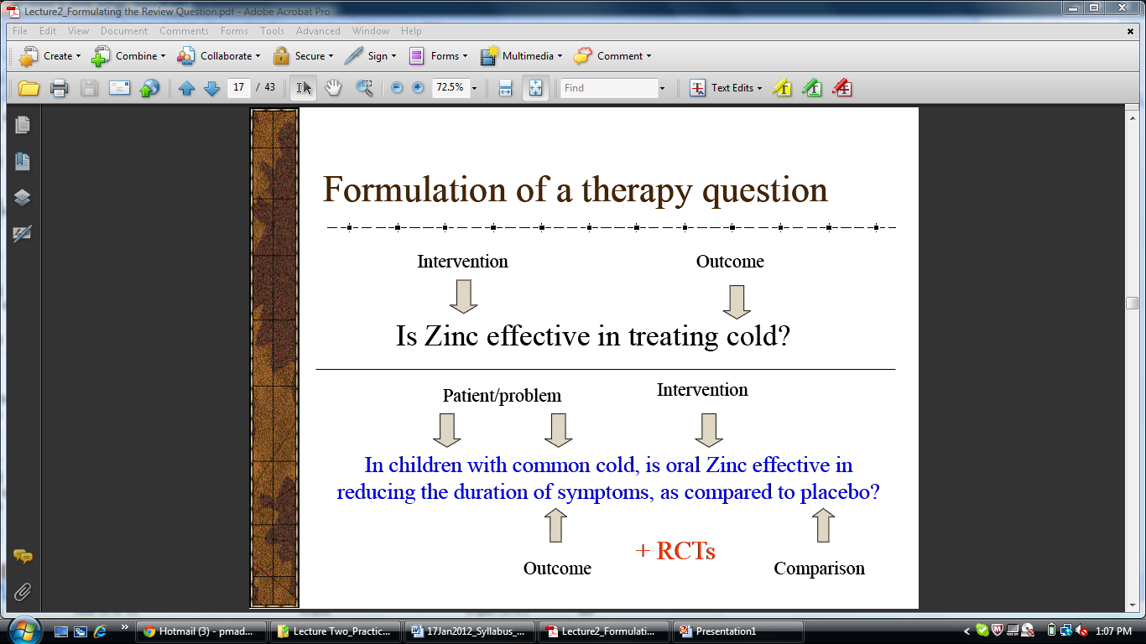
Formulation of a therapy question

Slide 17
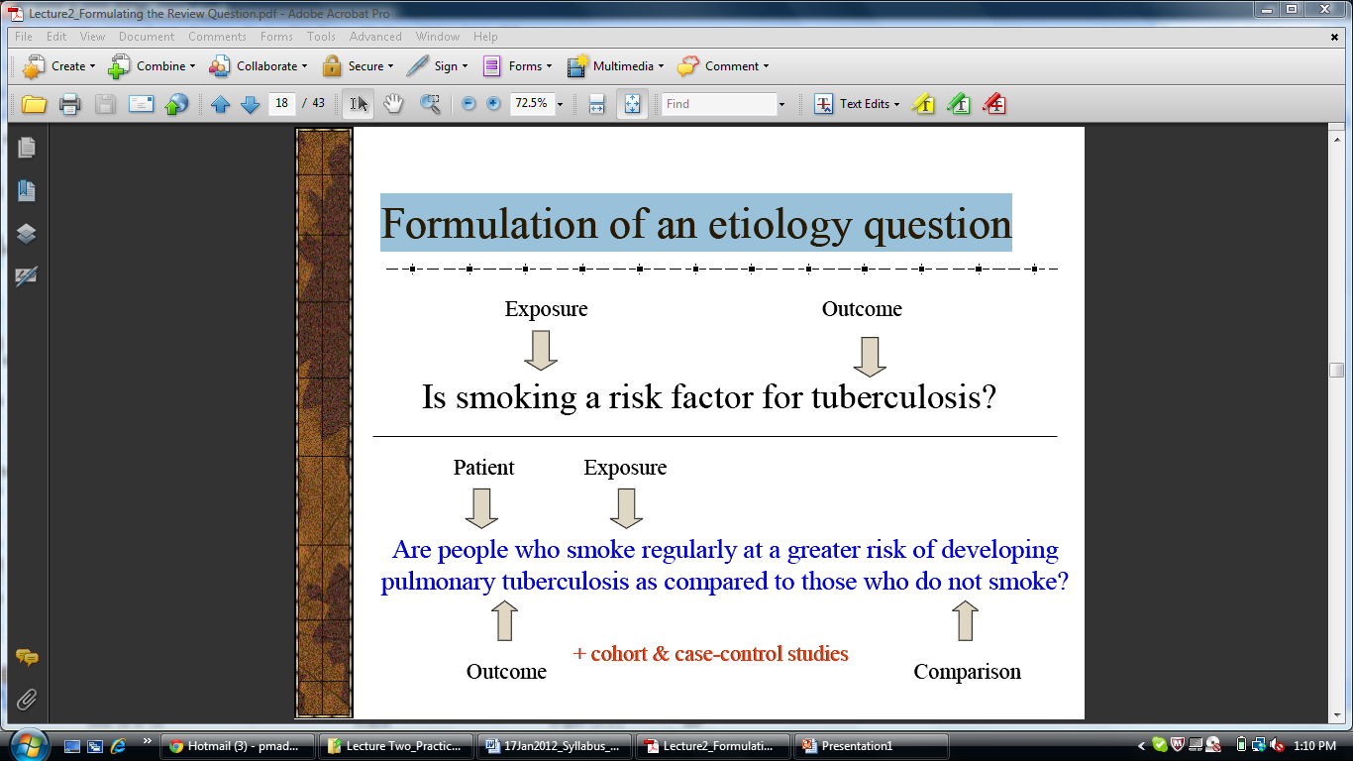
Formulation of an etiology question

Slide 18
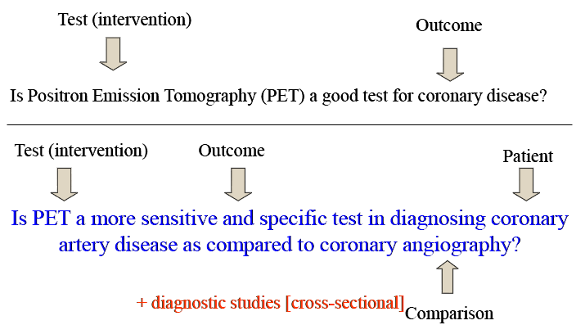
Formulation of a diagnosis question

