Slide 1
Biostatistics in relation to Research
Sumithra Selvam
St. John’s Research Institute

Slide 2
Learning Objectives
Nature of data
Scales of measurement
Measures of Central Tendency
Measures of dispersion
Sample Size

Slide 3
Data and Variables
Information related to the research question
Anything that changes, in a study
Varies from person to person
Eg: Age, sex, weight, height
Something you measure, Eg: Weight, Height
Condition you change, Eg: When studying effect of 2 types of diet on Overweight / Obese subjects

Slide 4
Quantitative Data Discrete and Continuous variables
Discrete-Can vary by fixed amounts only
Number of times BP was checked since last visit
Continuous-Can vary by arbitrary amounts
Age, weight, height, Systolic BP (mm/Hg)

Slide 5
Qualitative Data Categorical variables
Binary – Present / Absent
Nominal – Blood group A / B/ AB /O
Ordinal – Mild / Moderate /Severe

Slide 6
Types of Data
M=1,F=0 Scale: 1-4
Nominal Ordinal
Continuous

Slide 7
The scale of measurement can be changed by grouping data, Hb can be considered as continuous variable or
a categorical variable (Anaemic vs Normal) on a nominal scale
Information is lost by collapsing continuous variables into categories
The cut off at which data is grouped will be of significance
But, Grouping of data is essential when it is more meaningful, and for better graphical representation

Slide 8
Central tendency
Making frequency tables and graphs gives an overview of data
Not sufficient to summarize data
For this we need to know
Which are the most central (i.e. the most common or typical) values?
Think of this value as where the middle of a distribution lies
Eg: Weight of the children in the study

Slide 9
Measures of Central Tendency
Arithmetic Mean- average value of all the data: affected by extreme data
Median- value above and below which 50%
of the data lies when arranged in order: not affected by extreme data
Mode- most frequent value in the data set

Slide 10
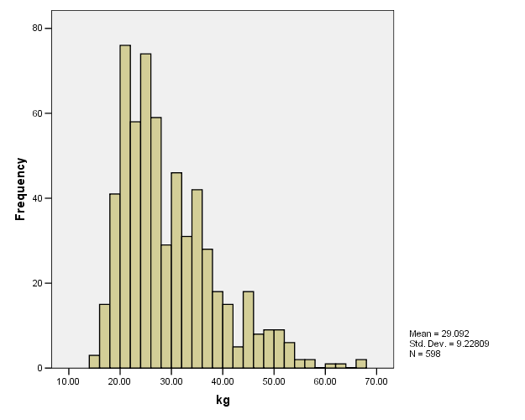
Original Data | 55 | 36 | 98 | 5 | 56 | 62 | 55 | 77 | 41 | 56 | 56 | 50 | 58 | 81 | 55
Ordered data | 5 | 36 | 41 | 50 | 55 | 55 | 55 | 56 | 56 | 56 | 58 | 62 | 77 | 81 | 98
Positions | 1 | 2 | 3 | 4 | 5 | 6 | 7 | 8 | 9 | 10 | 11 | 12 | 13 | 14 | 15
Median |  |  |  |  |  |  |  | M
Mean
Median

Slide 11
The Mode
The category or score with the largest frequency (or percentage) in the distribution
Mode=2

Slide 12
Measures of Dispersion
Describes the spread of the data or its variation around a central value. It help us to understand how different the data values are from one another

Slide 13
Range
Indicates the difference between the highest and lowest numbers in the data.
Advantages
It is easy to calculate.
Disadvantages
Uses only two values in the distribution.
Does not tell about the variability of the values within the distribution.
Eg. Data: {4, 4, 4, 4, 50} Range = 46
Data: {4, 8, 15, 24, 39, 50} Range = 46
The range is the same in both cases, but the data sets have very different distributions.

Slide 14
Inter quartile Range
It is the difference between the upper quartile and the lower quartile(Q3-Q1).
Original Data | 55 | 36 | 98 | 5 | 56 | 62 | 55 | 77 | 41 | 56 | 56 | 50 | 58 | 81 | 55
Ordered data | 5 | 36 | 41 | 50 | 55 | 55 | 55 | 56 | 56 | 56 | 58 | 62 | 77 | 81 | 98
Positions | 1 | 2 | 3 | 4 | 5 | 6 | 7 | 8 | 9 | 10 | 11 | 12 | 13 | 14 | 15
Median |  |  |  | Q1 |  |  |  | M |  |  |  | Q3
Interquartile Range = 62-50=12
Quartiles contain equal numbers but not equal ranges

Slide 15
Standard Deviation
A measure of variation which is based on the mean. A measure of dispersion that considers all values
SD looks at the differences between individual (Y) values and the mean.

Slide 16
Interpretation:
A small SD indicates that values are close to the average value.
A large SD indicates that values are further away from the average value.
The lowest value of a standard deviation is 0. This means that there is no variation (i.e. all the values are same)

Slide 17
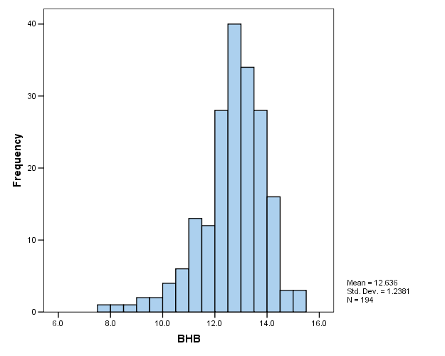
Frequency distributions
Pattern obtained from measuring a large number of individuals
Usually examined by histograms

Slide 18
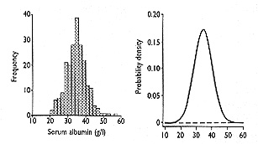
Probability Distributions
Slide 18

Slide 20
Types of Research
Depends on
The research question
The study setting
Resources available etc..
Descriptive studies
Analytical Studies
Experimental studies

Slide 21
Requirement for Sample Size
What is the primary objective of the study?
What is the primary outcome?
Number of groups
One group – Descriptive study
Comparison of groups ( Case control, Cohort, Clinical Trails)
Clinically expected variation or meanings difference
Precision, confidence interval
Type 1 error or Type II error

Slide 22
Descriptive Studies

Slide 23
Descriptive Study
What is the prevalence of anaemia among adolescent girls?
Primary Outcome | Proportion of anaemia among girls (Categorical Outcome)
Number of groups | One
Sample size Requirement Precision Confidence interval | What does the literature say on prevalence of anemia in adolescent girls? (say 40% ) | How precise should the estimate be? (maybe 5% error can be permitted in the estimate)
Formula | Z= Standardized Normal deviate - 1.96 p = Proportion or Prevalence of interest q = 100 – p d = Clinically expected variation/precision
Summary Statistics | Expressed as Proportion or percentages 95% confidence interval

Slide 24
Descriptive Study
Example
What is the mean haemoglobin level among adolescent girls?
Primary Outcome | Mean haemoglobin level (Continuous Outcome)
Number of groups | One
Sample size Requirement Precision Confidence interval | What does the literature say the mean hb level among adolescent girls? (say mean 11.9 with SD of 1.8 ) | How precise should the estimate be? (the precision as 0.80.)
Formula | Z= Standardized Normal deviate - 1.96 p = Proportion or Prevalence of interest q = 100 – p d = Clinically expected variation/precision
Summary Statistics | Expressed as mean with SD 95% confidence interval

Slide 25
Descriptive study-when associations are explored
Additional questions on association between variables
Eg: Is there an association of anemia with place of residence (urban/rural)
Nature of variables: Both categorical
Can be explored using chi-square test
Eg: Is there an association of anemia with school attendance as number of days of attendance
Nature of variables: One continuous and the other categorical
Can be explored using independent sample test

Slide 26
Clinical trials

Slide 27
Randomized controlled trials
There will be two groups: Intervention and control
Control could be placebo or standard
Exposures or independent variable - will be categorical, i.e., intervention/control
Outcomes or response variable - can be categorical or continuous
Example: MI in group with Aspirin vs Placebo
Outcome is categorical – presence of MI
Exposure variables will be categorical – Either Aspirin or Placebo

Slide 28
RCT studies - Testing of significance
Chi-square test will be used if we were to compare the presence of MI between Aspirin and placebo group.
Independent t test will be used if were to compare the mean age of the subjects between Aspirin and Placebo group
Relative risk will be used to assess the risk of subjects who are on Aspirin as compared to placebo
RR of MI was 0.80 (95% CI: 0.78, 0.82) in Aspirin intervention group vs Placebo
Subjects randomized to the aspirin arm had 20% lower risk of developing MI during follow up vs those on Placebo

Slide 29
RCT sample size: categorical outcome
Where
Z_{α} = Z value for α level
Z_{β} = Z value for β level
p = average percentage between two groups
q = 100 - p
d = Clinically meaningful difference between two
groups

Slide 30
Example (Qualitative) :
P = (16.7+4.2)/2=10.4%
q = 89.6%
Z_{α}= 1.96 for α at 0.05
Z_{β} = 1.282 for β at 0.10
in each arm

Slide 31
RCT sample size: continuous outcome
Where
Z_{α} = Z value for α error
Z_{β} = Z value for β error
S = Common standard deviation between two groups
d = Clinically meaningful difference

Slide 32
Case-control studies

Slide 33
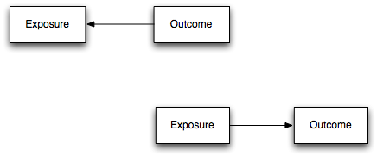
Case-control studies
Study to examine the association between risk factors and outcome
There will be two independent groups:
Cases (those with outcome of interest)
Controls (those without the outcome of interest)
Exposures could be categorical or continuous
Statistical measure:
Odds ratio and 95% confidence interval
Will give the odds of exposure among cases vs controls
Time
Past
Present
Future

Slide 34
Case-control studies
Eg: Mothers who delivered small for gestational age babies (SGA) vs normal babies
The exposures could be variables related to pregnancy
PIH
such as low weight gain in pregnancy,
Type of variable:
outcome is categorical
Exposure variables are both continuous and categorical
Logistic regression will give OR with 95% confidence interval
OR of PIH: 1.08 (95% CI: 1.02, 2.04)
The mothers of SGA babies were 8% more likely to have had PIH compared to Normal

Slide 35
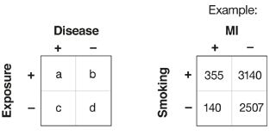
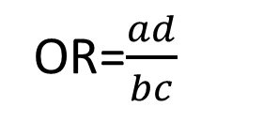
Case-control Study: 2 X 2 Table
OR=$\frac{ad}{bc}$
OR = (355 *2507) / (140 * 3140)
= 889985 / 439600
OR = 2.02

Slide 36
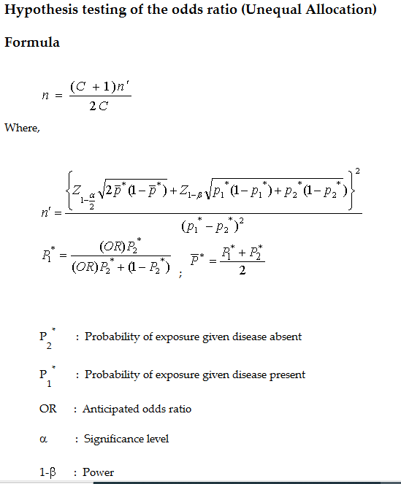
Sample Size formula for Case Control Study

Slide 37
Sample size - Requirement from literature for case control
% exposure among cases and control or Odds Ratio
Case control could be in the ratio 1:1 or 1:m (depending on whether cases or controls are easier to recruit)
Eg: A sample of 200 SGA and 200 normal babies are required to examine the its association with PIH considering 7% of normal babies had mothers with PIH.

Slide 38
Cohort Studies

Slide 39
Cohort Studies
Time
Past
Present
Future
There will be one groups which is the cohort
Exposures could be categorical or continuous
Outcomes are typically categorical
Statistical measure:
Relative Risk and 95% confidence interval
Will give the risk of incidence of outcome among those with exposure vs those without exposure

Slide 40
Cohort studies
Eg: Birth cohort to examine the effect of appropriate breastfeeding on cognitive development at 2 years
The exposures would be variables related to child as it grows
Exclusively breast fed until 6 months
Type of variable:
outcome is categorical (Poor development / Optimum development)
Exposure variables can be both continuous and categorical
Log binomial regression will give Risk Rate with 95% confidence interval
RR of Poor development vs non-EBF: 2.0 (95% CI: 1.5, 2.5)
Babies who were non-EBF were twice as likely to have poor cognitive development

Slide 41
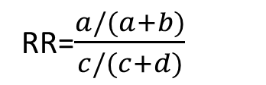
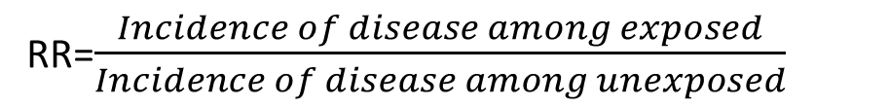
Cohort Study: 2 X 2 Table
 | Disease | No Disease
Exposed | a | b | a + b
Unexposed | c | d | c + d
Total | a + c | b + d | n
RR=$\frac{Incidence of disease among exposed}{Incidence of disease among unexposed}$
RR=$\frac{a/(a+b)}{c/(c+d)}$

Slide 42
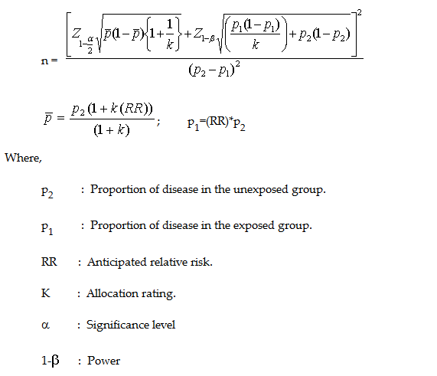
Sample Size formula for Cohort Study

Slide 43
Cohort study sample size:
Eg: A sample of 200 EBF and 200 non-EBF babies are required to examine the its association with poor cognitive development. If prevalence of EBF is 30% then we need to recruit a cohort of 667 babies such that we get 200 EBF babies . The rest will be non-EBF.

Slide 44
In a grant proposal
Brief statistical methods should be described based on
Research question
Study design
Nature of data
Number of groups studies
Detail of sample size calculation should be given based on
Study design
Nature of data
Number of groups studies

Slide 45
Sample Size and Statistical Analysis Plan
Sample Size and Statistical analysis is harder than it looks.
Get help now, before you start writing.
When in doubt, call statistician.
When not in doubt, call statistician
Notes:
Speaker Notes:
Some of the most common data analysis software are: Microsoft Access, Microsoft Excel; Epi-Info; SPSS; Stata and SAS. Most of you probably have access to the Microsoft programs on your computers. Epi-Info is free. The other three software are not free and some have a considerable cost. Fortunately, much of the data analysis for programs can be done using Microsoft Excel.

Slide 46
Thank you

